Slide 1
Research Platform for Custom Memory Cube
Yu Zou
Vinayak Deshpande
Peter Harduvel
Dr. Herman Lam
Assoc. Professor of ECE
University of Florida

Slide 2
Outline
Review & overview
Notional CMC architecture
Performance measurements on Merlin board
Mapping notional CMC to Merlin board
Experiments & measurements
Non-overlapping memory access
Simple read & write ops, DRE ops
Overlapping memory access
Simple read & write ops, DRE ops
Simplified CMC-to-Merlin mapping
Performance mapping of DRE operations
Case study result of random access app.
Going forward
* DRE: Data rearrangement/reordering engine ** CMC Computational Memory Cube

Slide 3
Outline
Review & overview
Notional CMC architecture
Performance measurements on Merlin board
Mapping notional CMC to Merlin board
Experiments & measurements
Non-overlapping memory access
Simple read & write ops, DRE ops
Overlapping memory access
Simple read & write ops, DRE ops
Simplified CMC-to-Merlin mapping
Performance mapping of DRE operations
Case study result of random access app.
Going forward
* DRE: Data rearrangement/reordering engine ** CMC Computational Memory Cube

Slide 4
Notional CMC Architecture*
Simplified view: an HMC with a user-programmable logic layer
* Nair, R., et al. "Active Memory Cube: A processing-in-memory architecture for exascale systems.“ IBM Journal of Res. & Development 59.2/3 (2015): 17-1.

Slide 5
DRE* Prototype on CMC Architecture
VB3
VB2
VB1
VB3
View buffer (VB) can be set up on host (design option 1), inside the HMC (design option 2) or inside CMC logic (design option 3)
* DRE: Data Reordering/Rearrangement Engine Lawrence Livermore Nat. Labs

Slide 6
Performance Measurement on Merlin Board
F3
CMC platform on Merlin board
**
M3 M4 M5
E’
Instrumented Merlin infrastructure with hardware performance monitors
(A’, B’, C’, D’, M1, M2, M3, M4, M5, and E’ )
Progress: Able to measure all listed parameters except:
M4, M5: Exploring with help from Convey
E’: Exploring with help with Micron under NDA

Slide 7
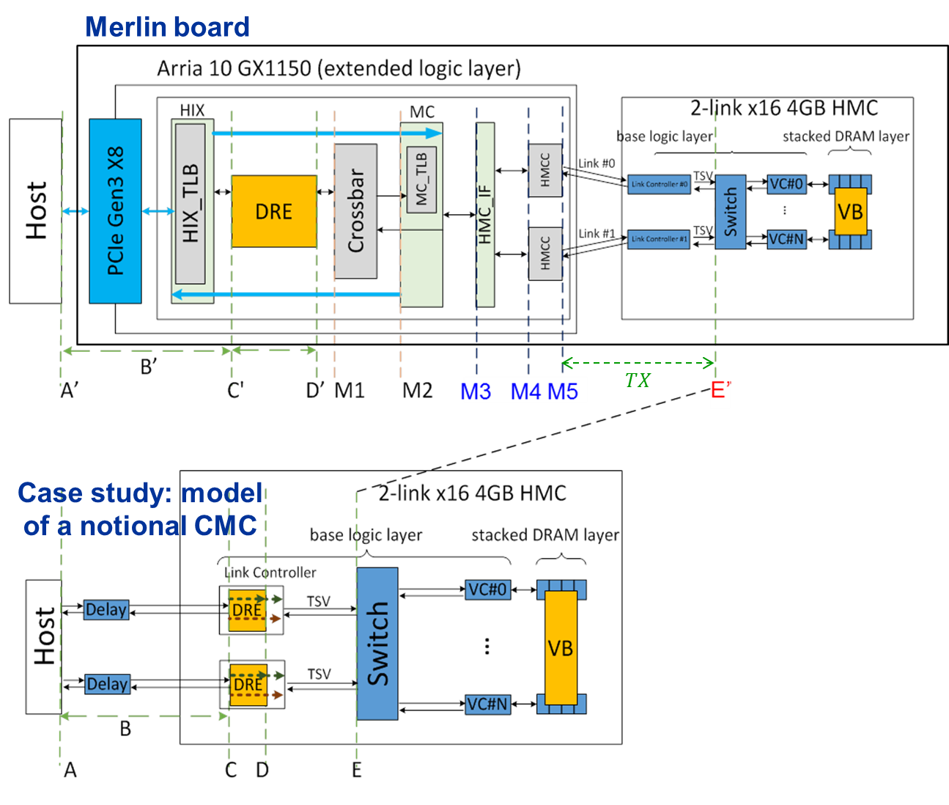
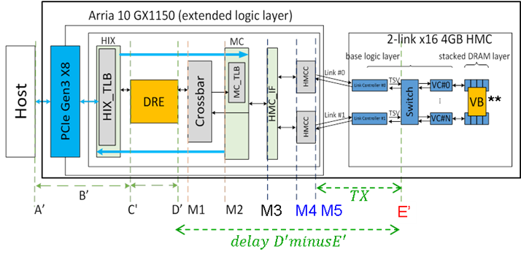
Mapping Notional CMC onto Merlin Board

Slide 8
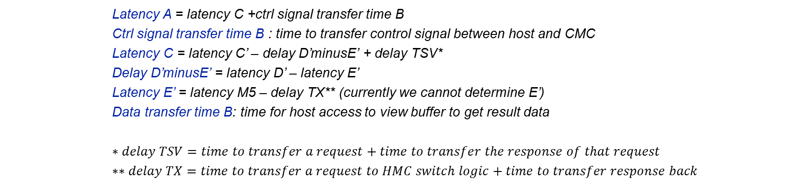


Model of CMC-to-Merlin Mapping
Model of notional CMC
CMC platform on Merlin board
**
$$TX$$
M3 M4 M5
E’
$$delay D^{′}minusE^{′}$$
Latency A = latency C +ctrl signal transfer time B
Ctrl signal transfer time B : time to transfer control signal between host and CMC
Latency C = latency C’ – delay D’minusE’ + delay TSV*
Delay D’minusE’ = latency D’ – latency E’
Latency E’ = latency M5 – delay TX** (currently we cannot determine E’)
Data transfer time B: time for host access to view buffer to get result data
$$∗delay TSV=time to transfer a request+time to transfer the response of that request$$
$$∗∗delay TX=time to transfer a request to HMC switch logic+time to transfer response back$$
Latency: round-trip delay from input into a point in the system to desired outcome

Slide 9
Outline
Review & overview
Notional CMC architecture
Performance measurements on Merlin board
Mapping notional CMC to Merlin board
Experiments & measurements
Non-overlapping memory access
Simple read & write ops, DRE ops
Overlapping memory access
Simple read & write ops, DRE ops
Simplified CMC-to-Merlin mapping
Performance mapping of DRE operations
Case study result of random access app.
Going forward
* DRE: Data rearrangement/reordering engine ** CMC Computational Memory Cube

Slide 10
Review of DRE setup, fill, drain
void setup(value_pointer refp, index_pointer indexp, value_pointer sp)
{
ref_base = refp;
idx_base = indexp;
scratchpad = sp;
}
void fill() {
for (size_t i = 0; i < scratchpad.length(); i++) {
scratchpad[i] = ref_base[idx_base[i]];
}
}
void drain() {
for (size_t i = 0; i < scratchpad.length(); i++) {
ref_base[idx_base[i]] = scratchpad[i];
}
}

Slide 11
Non-overlapping Memory Access
Consistent with expectation: M1 > M2 > M3 > M4 > M5 > E’
Measured performance: simple read/write (µs)
(Averaged over 100,000 iterations)
Where is M4 and E’?
Oper. | A’ (µs) | C’ | D’ | M1 | M2 | M3
Read | 1095.6 | 1.03 | 1.006 | 0.923 | 0.725 | 0.519
Write | 1104.0 | 1.071 | 1.011 | 0.991 | 0.793 | 0.577
Measured performance: Vector Addition in ms (100,000 iterations of 2 reads & 1 write)
A’ (ms) | C’ | D’ | M1 | M2 | M3
282.55 | 281.72 | 278.72 | 258.96 | 199.68 | 151.31
Measured performance: SpMV – DRE app in seconds (2²⁴ X 2²⁴ matrix)
A’ (s) | C’ | D’ | M1 | M2 | M3
1658.67 | 1580.14 | 1559.65 | 1460.57 | 1122.42 | 839.84

Slide 12
Overlapping Memory Access
M1, M2, M3, M4, M5, E’ have no significant difference
For pipelined overlapping memory access, discrepancy between M1, M2, M3, M4, M5, E’ is hidden by pipeline
Is it really “pipelined”?

Slide 13
Overlapping Memory Access
M1, M2, M3, M4, M5, E’ have no significant difference
For pipelined overlapping memory access, discrepancy between M1, M2, M3, M4, M5, E’ is hidden by pipeline
Is it really “pipelined”?

Slide 14
Outline
Review & overview
Notional CMC architecture
Performance measurements on Merlin board
Mapping notional CMC to Merlin board
Experiments & measurements
Non-overlapping memory access
Simple read & write ops, DRE ops
Overlapping memory access
Simple read & write ops, DRE ops
Simplified CMC-to-Merlin mapping
Performance mapping of DRE operations
Case study result of random access app.
Going forward
* DRE: Data rearrangement/reordering engine ** CMC Computational Memory Cube

Slide 15
Simplified Notional CMC Modeling
For pipelined overlapping memory operations, estimate:
M1 = M2 = M3 = M4 = M5 = E’
Model of notional CMC
CMC platform on Merlin board
**
$$TX$$
M3 M4 M5
E’
$$delay D^{′}minusE^{′}$$
Latency A = latency C +ctrl signal transfer time B
Ctrl signal transfer time B : time to transfer control signal between host and CMC
Latency C = latency C’ – delay D’minusE’ + delay TSV*
Delay D’minusE’ = latency D’ – latency E’
Latency E’ = latency M5 – delay TX** (currently we cannot determine E’)
Data transfer time B: time for host access to view buffer to get result data
Latency: round-trip delay from input into a point in the system to desired outcome

Slide 16
Simplified Notional CMC Modeling
For pipelined overlapping memory operations, estimate:
M1 = M2 = M3 = M4 = M5 = E’
Model of notional CMC
CMC platform on Merlin board
**
$$TX$$
M3 M4 M5
E’
$$delay D^{′}minusE^{′}$$
Latency A = latency C +ctrl signal transfer time B
Ctrl signal transfer time B : time to transfer control signal between host and CMC
Latency C = latency C’ + delay TSV*
Data transfer time B: time for host access to view buffer to get result data
* delay TSV = time to transfer request + time to transfer response
Latency: round-trip delay from input into a point in the system to desired outcome

Slide 17
Outline
Review & overview
Notional CMC architecture
Performance measurements on Merlin board
Mapping notional CMC to Merlin board
Experiments & measurements
Non-overlapping memory access
Simple read & write ops, DRE ops
Overlapping memory access
Simple read & write ops, DRE ops
Simplified CMC-to-Merlin mapping
Performance mapping of DRE operations
Case study result of random access app.
Going forward
* DRE: Data rearrangement/reordering engine ** CMC Computational Memory Cube

Slide 18
Parameters of Notional CMC Modeling
Start with 1 link 1 CMC core architecture (parameterized in the future)
BW_{link}
BW_{logic-vc}
W_{host-logic}
W_{logic-vc}
Not clear to me the purpose of the next 3 slides. The outline says “Case study result of random access app.”
Parameters of CMC architecture
Effective bandwidth of Host-CMC interface: BW_{link}
Bit width of Host-CMC message (request + response): W_{host-logic}
Data: W_{host-logic}(data) Ctrl: W_{host-logic}(ctrl)
Effective bandwidth of CMC logic – vault controller connection: BW_{logic-vc}
Bit width of logic-vault message (request + response): W_{logic-vc}

Slide 19
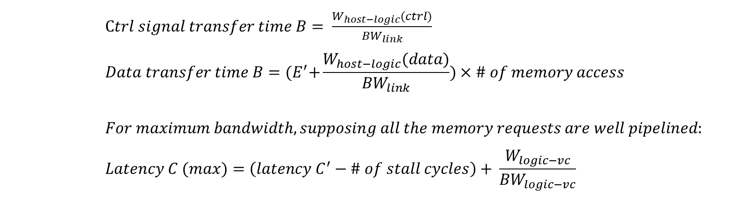
Performance Mapping of Single DRE Operation
Model of notional CMC
CMC platform on Merlin board
**
M3 M4 M5
$$TX$$
E’
$$delay D^{′}minusE^{′}$$
$Ctrl signal transfer time B= \frac{W_{host−logic}(ctrl)}{{BW}_{link}}$
$$Data transfer time B={(E}^{′}+\frac{W_{host−logic}(data)}{{BW}_{link}})×\# of memory access$$
$$For maximum bandwidth, supposing all the memory requests are well pipelined:$$
$$Latency C (max)=\left(latency C^{′}−\# of stall cycles\right)+ \frac{W_{logic−vc}}{{BW}_{logic−vc}}$$
Not clear to me the purpose of the next 3 slides. The outline says “Case study result of random access app.”

Slide 20
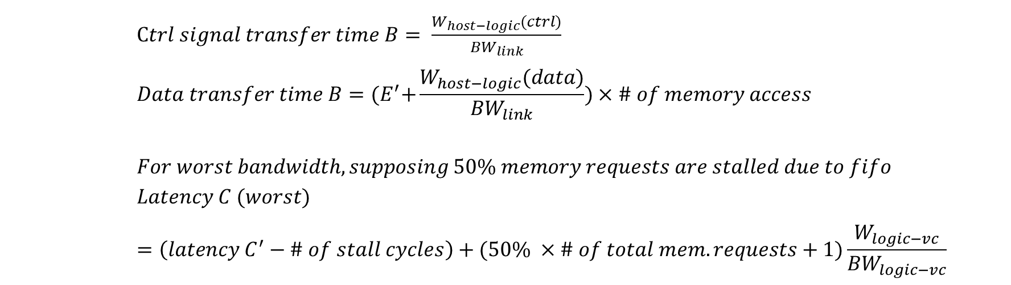
Performance Mapping of Single DRE Operation
Model of notional CMC
CMC platform on Merlin board
**
$$TX$$
Not clear to me the purpose of the next 3 slides. The outline says “Case study result of random access app.”
M3 M4 M5
E’
$$delay D^{′}minusE^{′}$$
$Ctrl signal transfer time B= \frac{W_{host−logic}(ctrl)}{{BW}_{link}}$
$$Data transfer time B={(E}^{′}+\frac{W_{host−logic}(data)}{{BW}_{link}})×\# of memory access$$
$$For worst bandwidth, supposing 50\% memory requests are stalled due to fifo$$
$$Latency C (worst)=\left(latency C^{′}−\# of stall cycles\right)+(50\% ×\# of total mem. requests+1)\frac{W_{logic−vc}}{{BW}_{logic−vc}}$$

Slide 21
Case Study Result for Random Access App.
Placeholder
Will update performance results here

Slide 22
Going Forward
Creating user-friendly CMC API
Share code and lessons with LPS
Visit LPS at some time
Continue researching on CMC modelling for multiple links multiple CMC cores
Study sorting and bloom filter on CMC

